Slide 1
R1
20231213

Slide 2
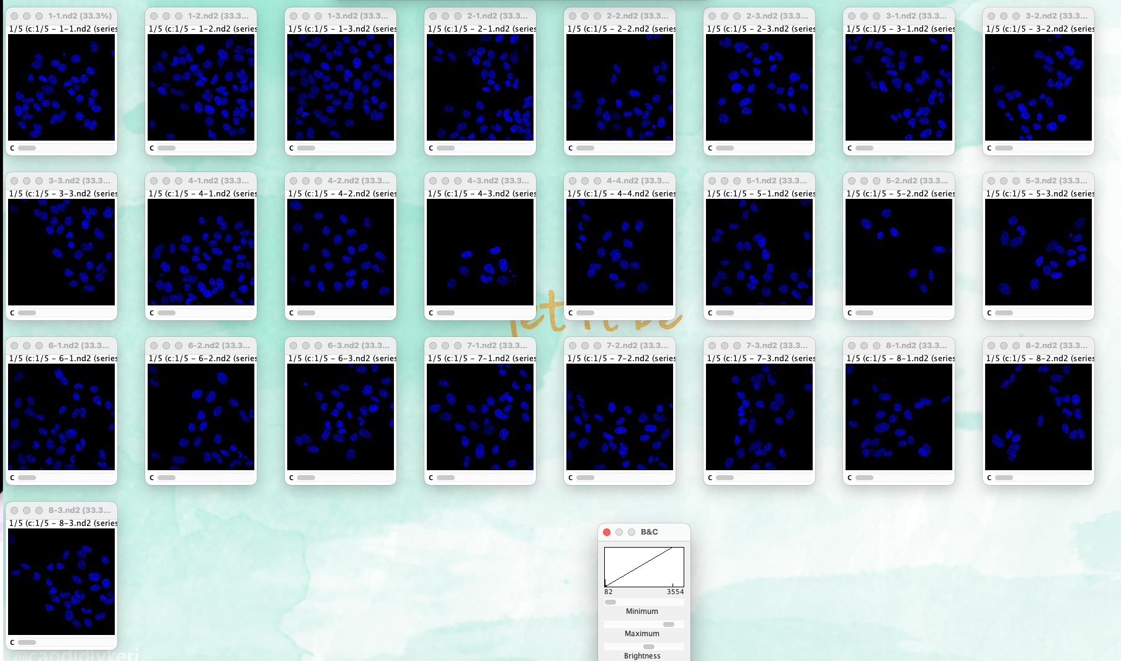
overview dap

Slide 3
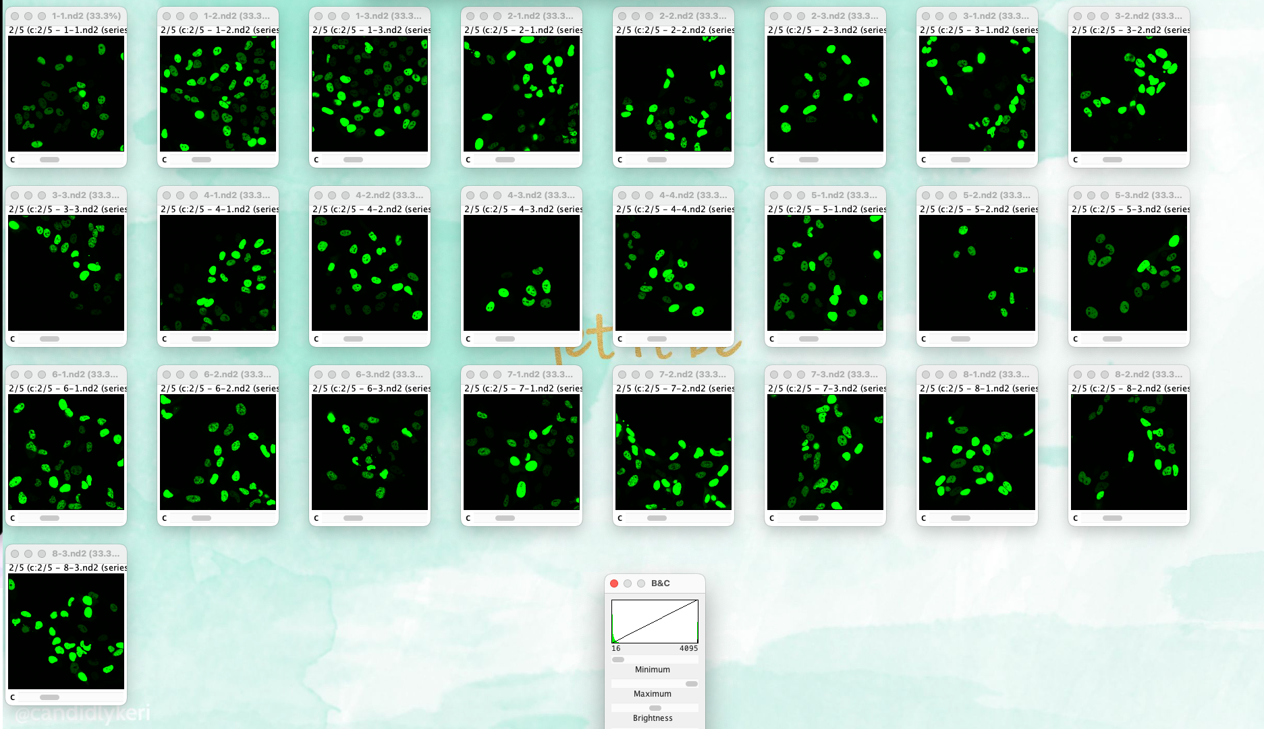
overview gfp

Slide 4
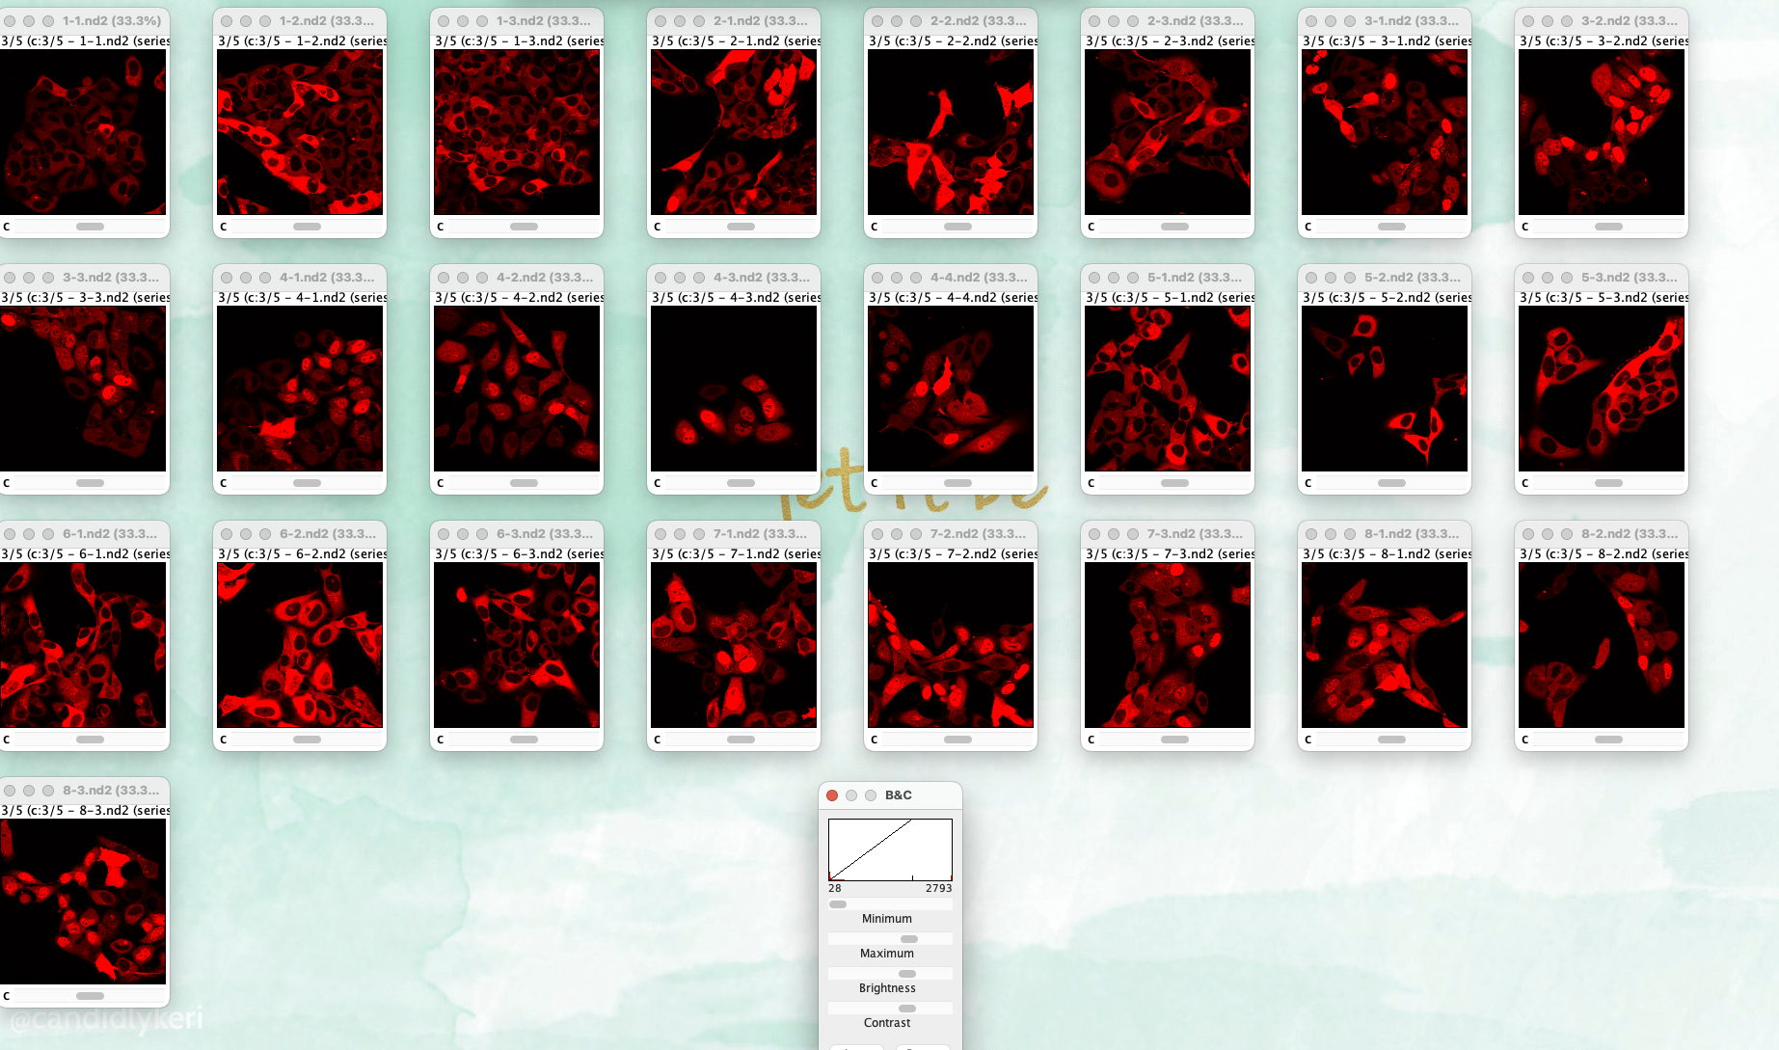
overview rfp

Slide 5
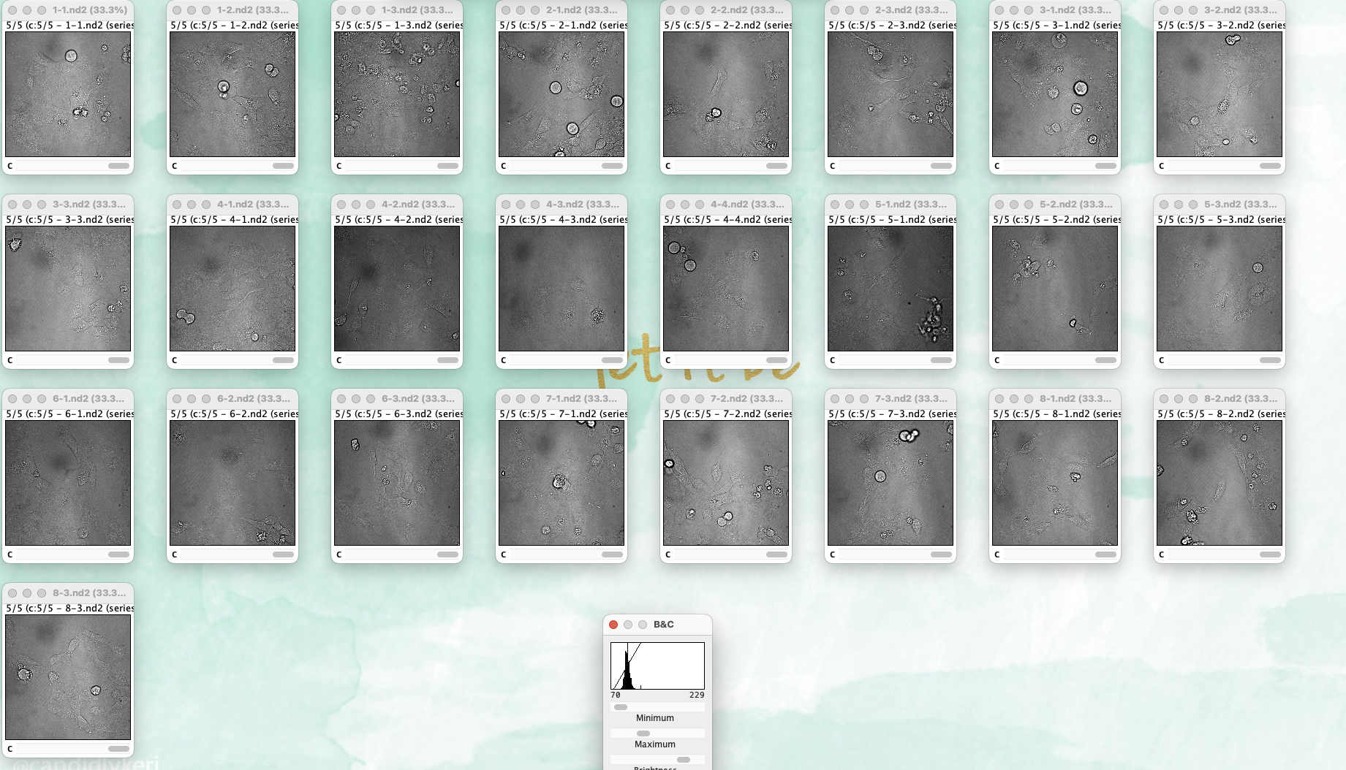
overview td

Slide 6
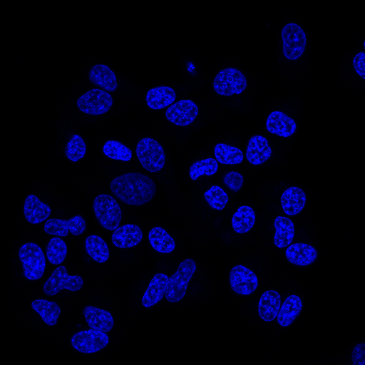
1-1-DAPI

Slide 7
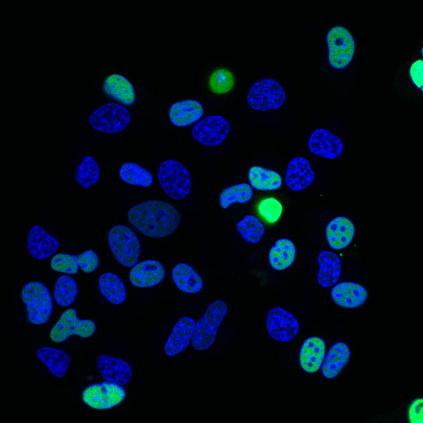
1-1-DAPI-GFP

Slide 8
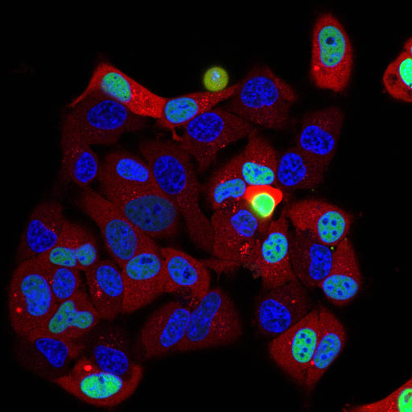
1-1-DAPI-GFP-RFP

Slide 9
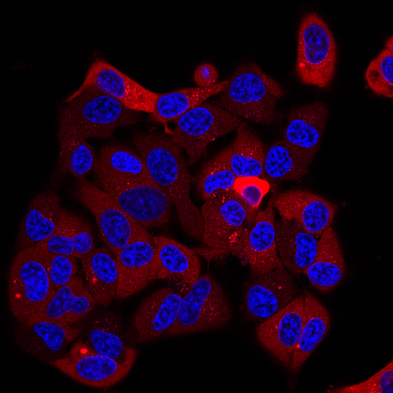
1-1-DAPI-RFP

Slide 10
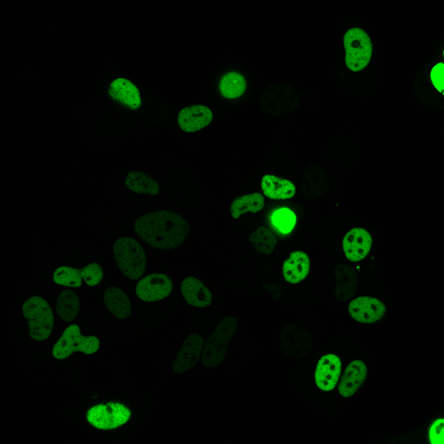
1-1-GFP

Slide 11
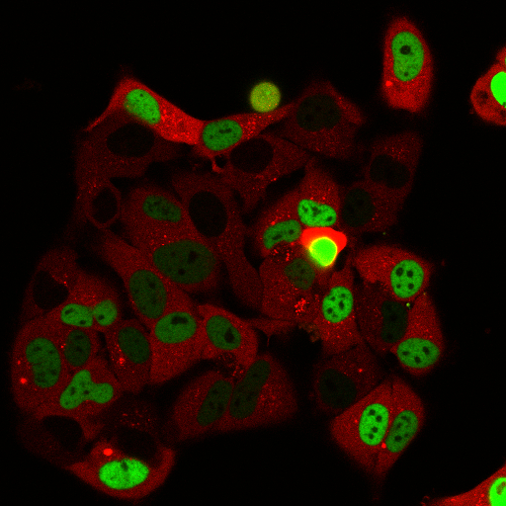
1-1-GFP-RFP

Slide 12
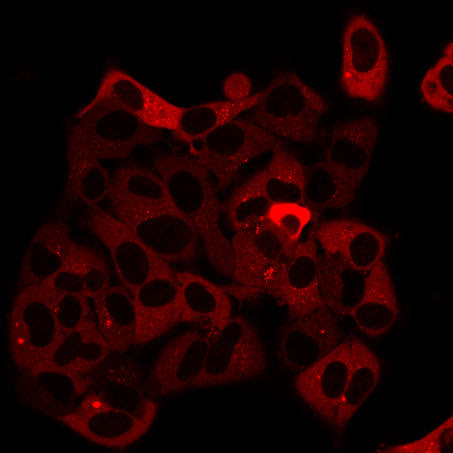
1-1-RFP

Slide 13
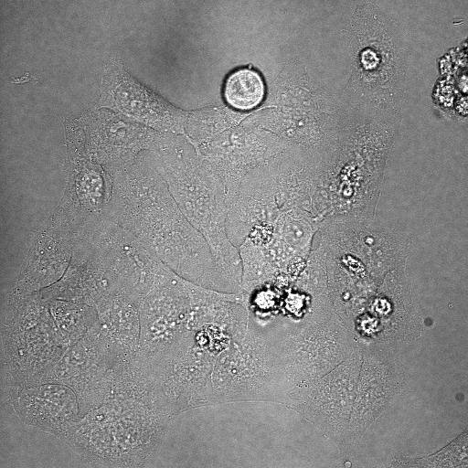
1-1-TD

Slide 14
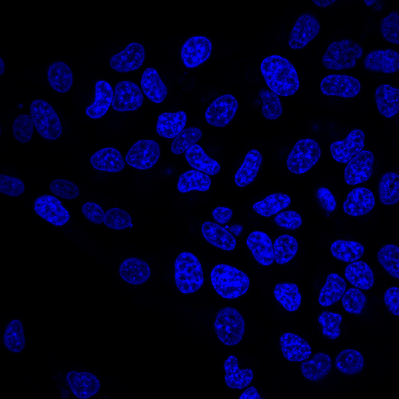
1-2-DAPI

Slide 15
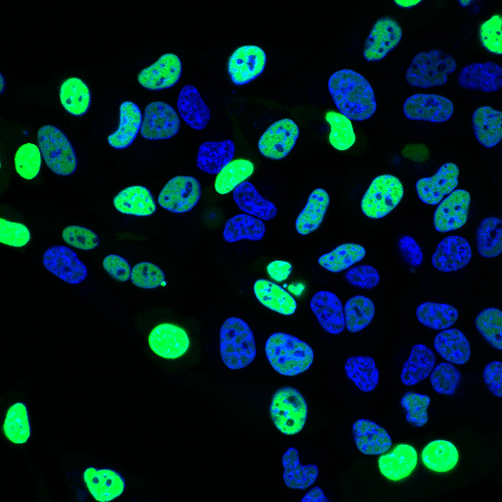
1-2-DAPI-GFP

Slide 16
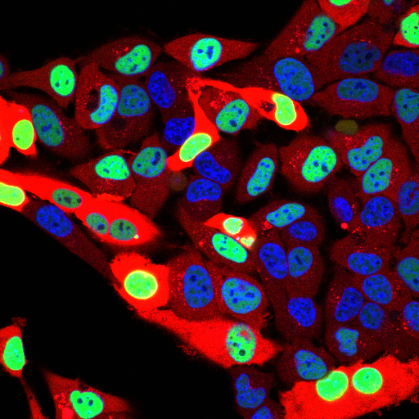
1-2-DAPI-GFP-RFP

Slide 17
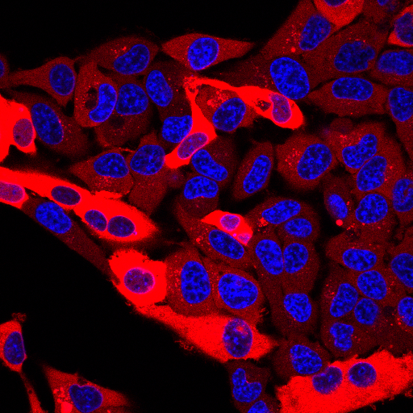
1-2-DAPI-RFP

Slide 18
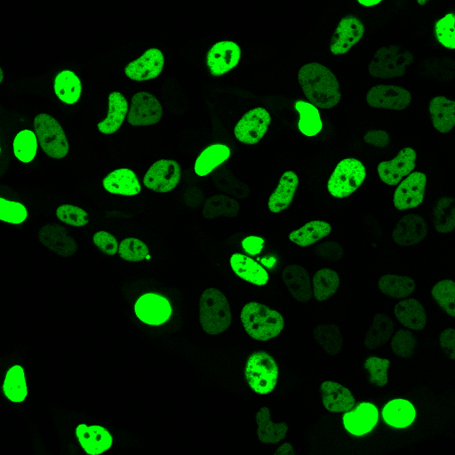
1-2-GFP

Slide 19
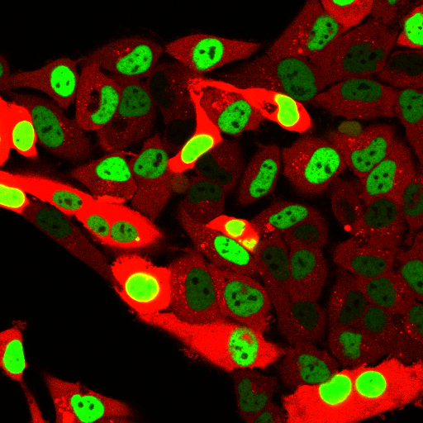
1-2-GFP-RFP

Slide 20
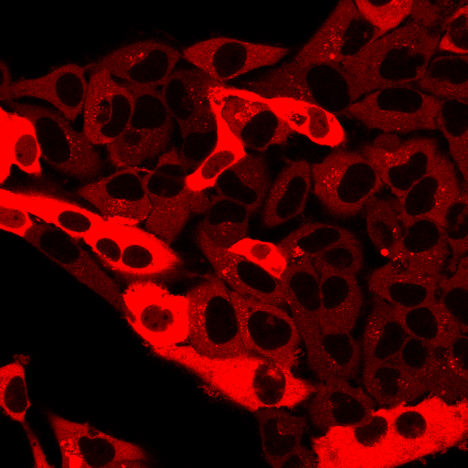
1-2-RFP

Slide 21
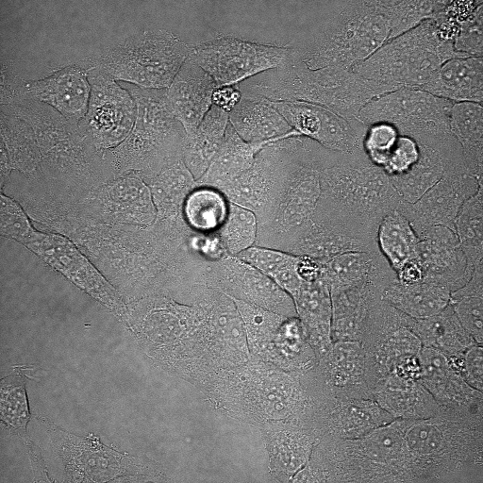
1-2-TD

Slide 22
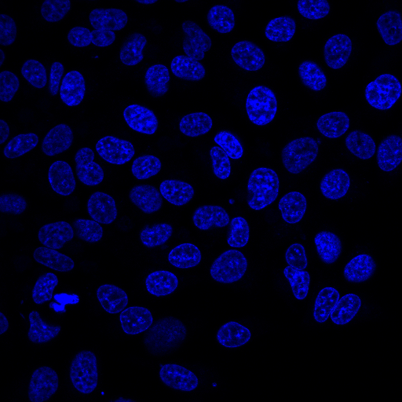
1-3-DAPI

Slide 23
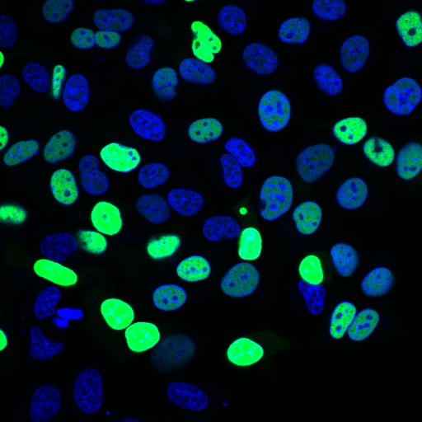
1-3-DAPI-GFP

Slide 24
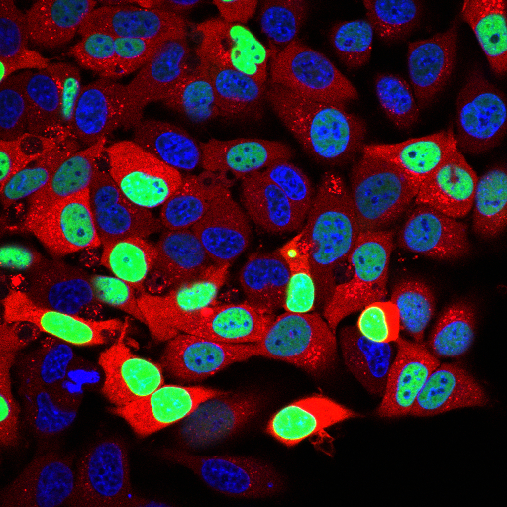
1-3-DAPI-GFP-RFP

Slide 25
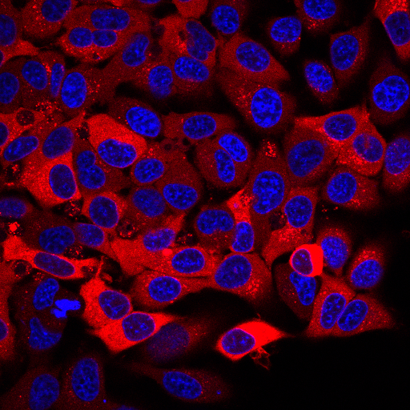
1-3-DAPI-RFP

Slide 26
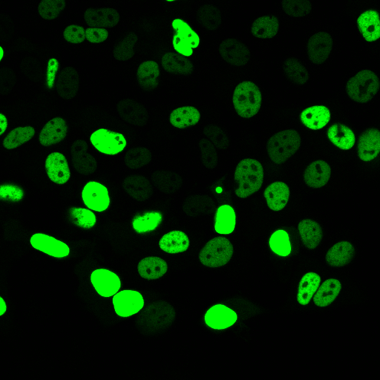
1-3-GFP

Slide 27
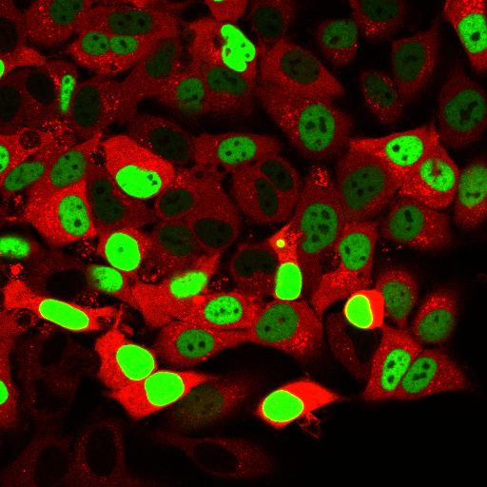
1-3-GFP-RFP

Slide 28
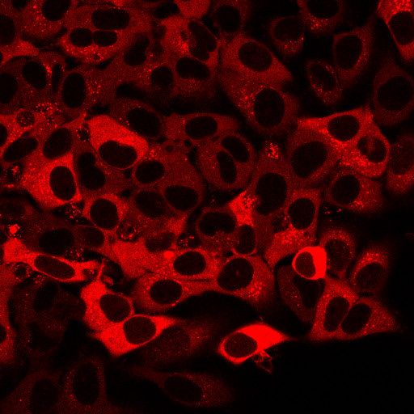
1-3-RFP

Slide 29
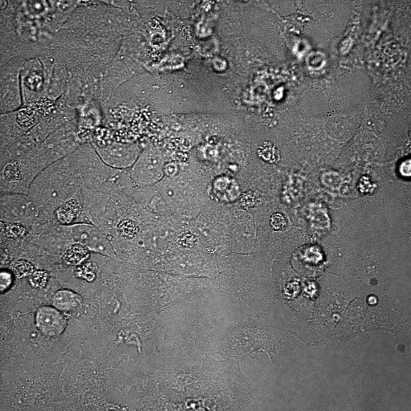
1-3-TD

Slide 30
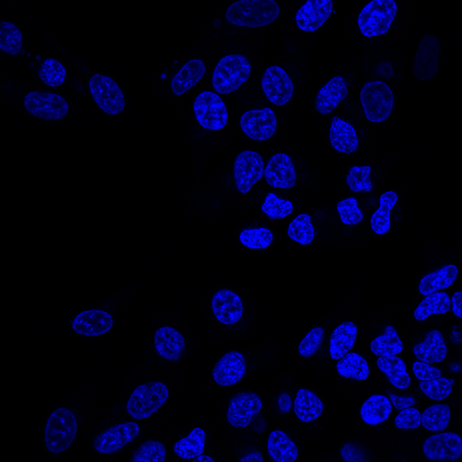
2-1-DAPI

Slide 31
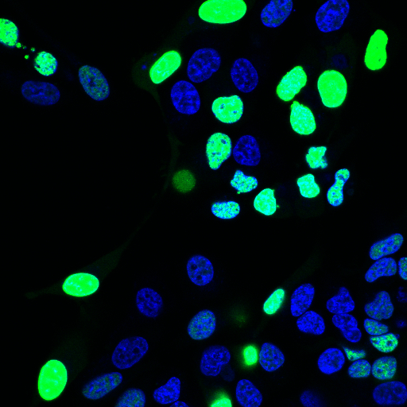
2-1-DAPI-GFP

Slide 32
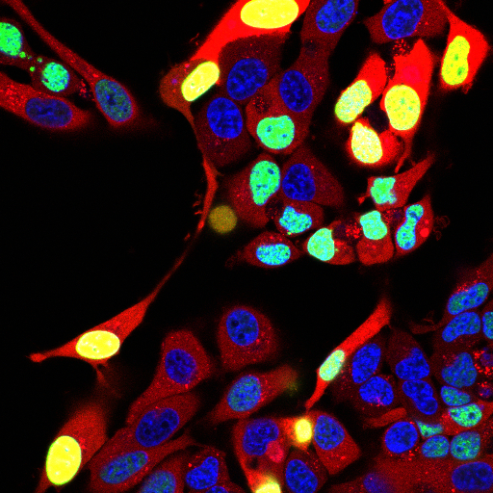
2-1-DAPI-GFP-RFP

Slide 33
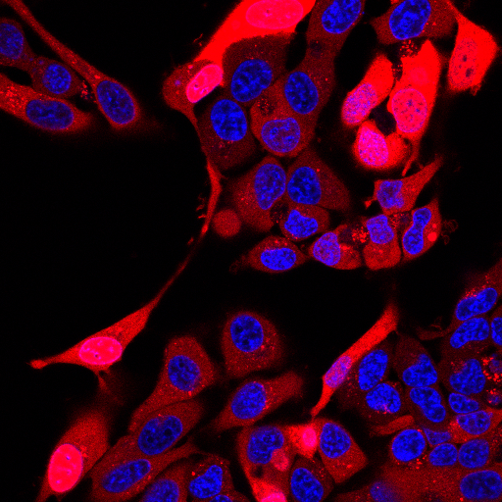
2-1-DAPI-RFP

Slide 34
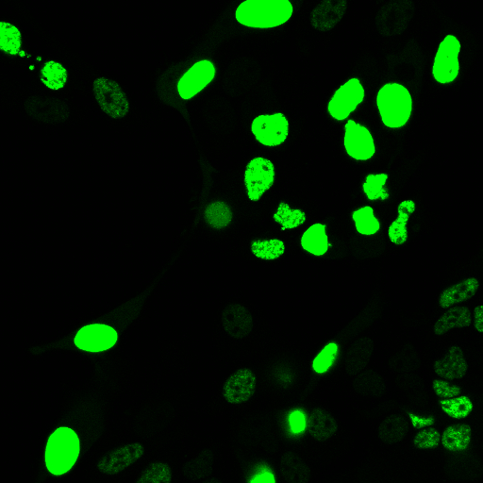
2-1-GFP

Slide 35
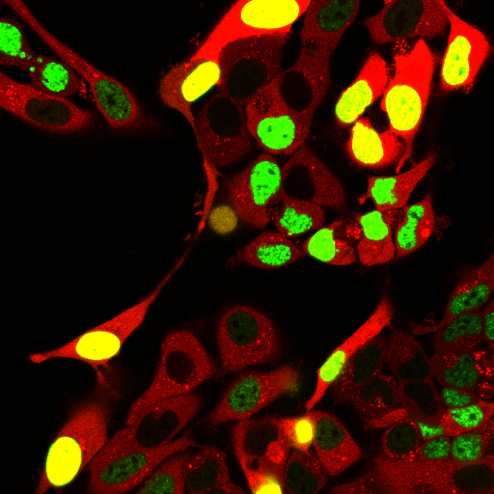
2-1-GFP-RFP

Slide 36
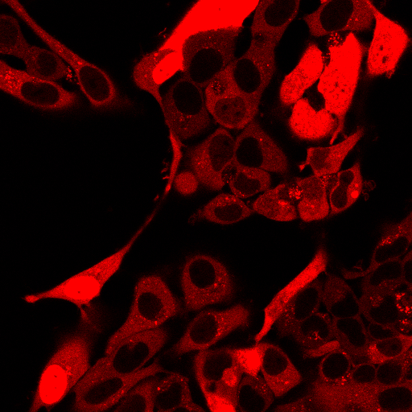
2-1-RFP

Slide 37
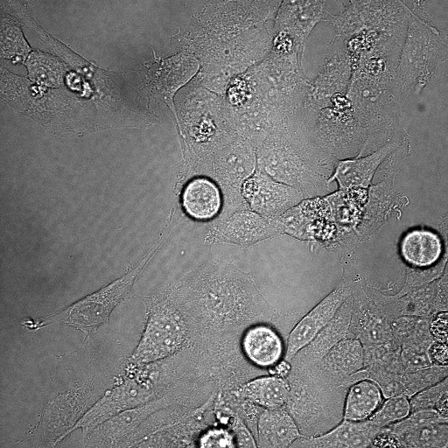
2-1-TD

Slide 38
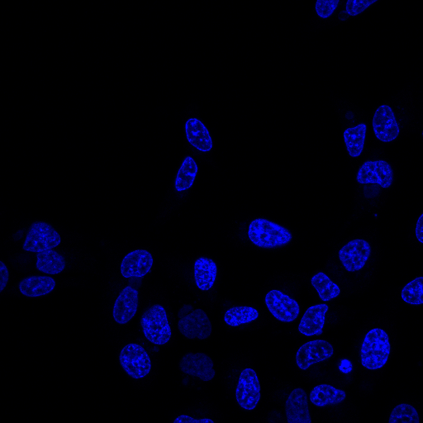
2-2-DAPI

Slide 39
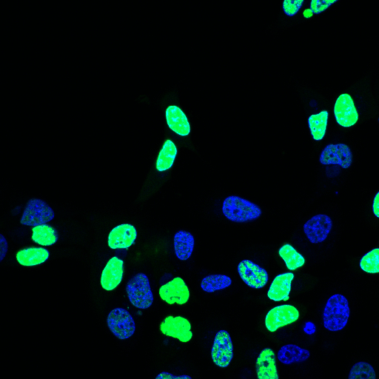
2-2-DAPI-GFP

Slide 40
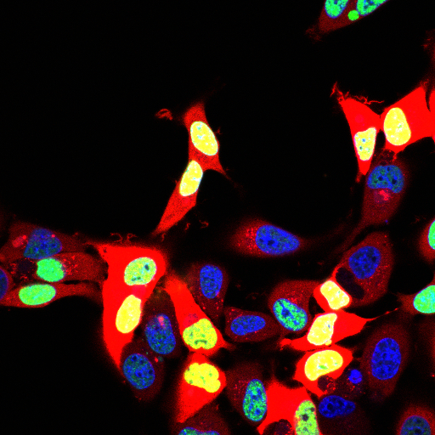
2-2-DAPI-GFP-RFP

Slide 41
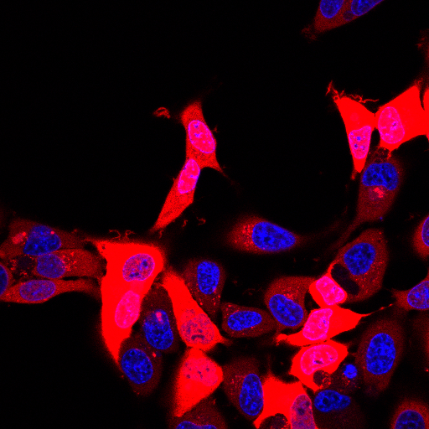
2-2-DAPI-RFP

Slide 42
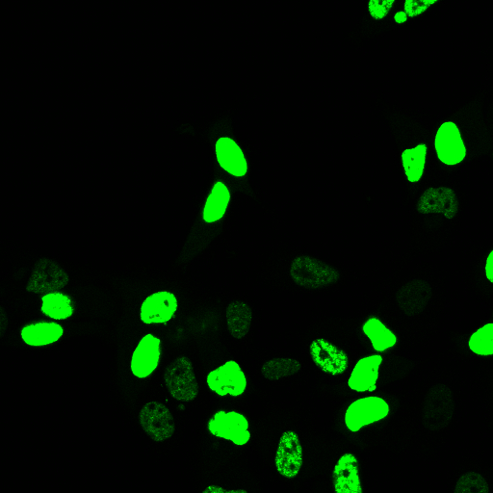
2-2-GFP

Slide 43
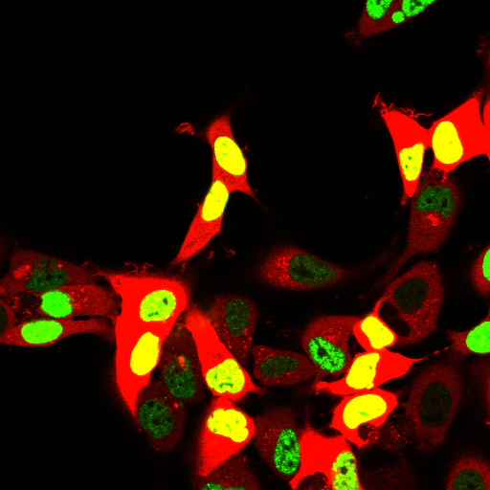
2-2-GFP-RFP

Slide 44
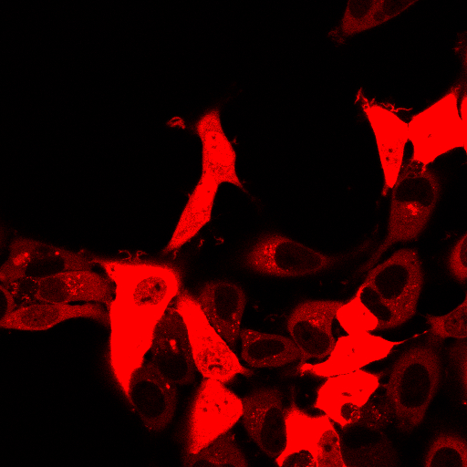
2-2-RFP

Slide 45
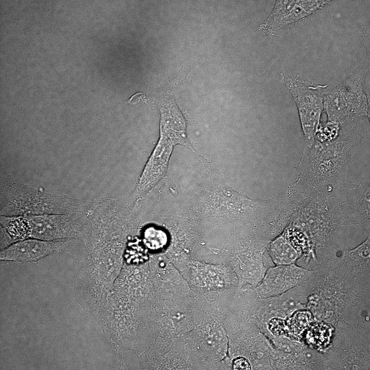
2-2-TD

Slide 46
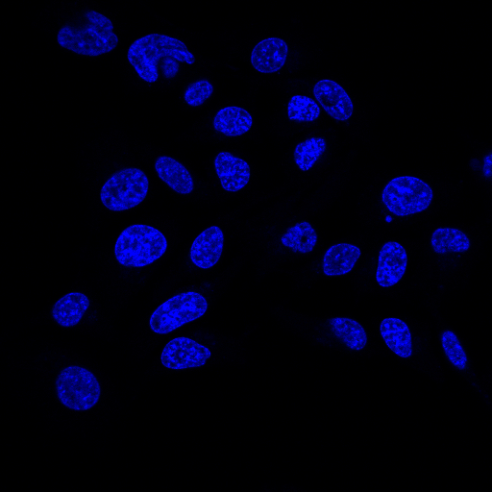
2-3-DAPI

Slide 47
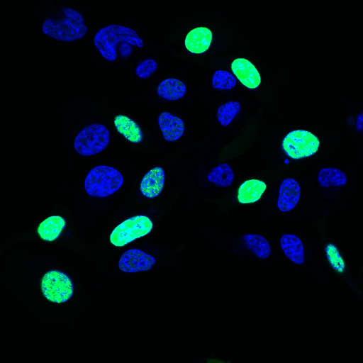
2-3-DAPI-GFP

Slide 48
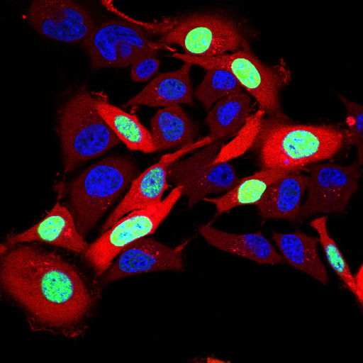
2-3-DAPI-GFP-RFP

Slide 49
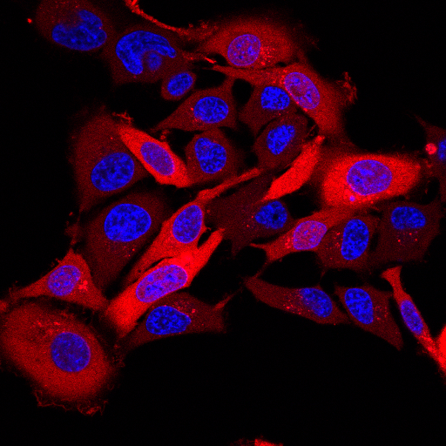
2-3-DAPI-RFP

Slide 50
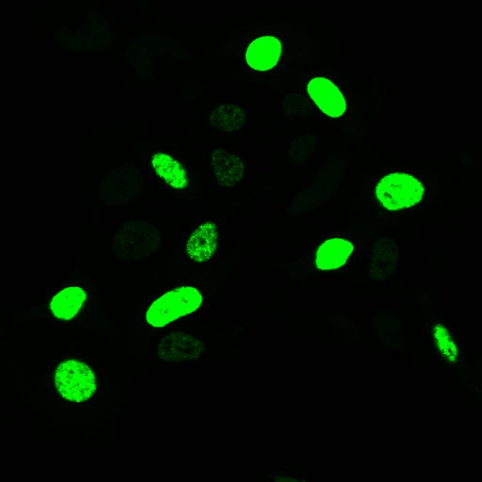
2-3-GFP

Slide 51
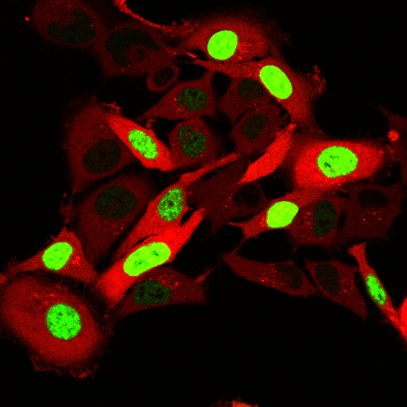
2-3-GFP-RFP

Slide 52

2-3-RFP

Slide 53

2-3-TD

Slide 54

3-1-DAPI

Slide 55

3-1-DAPI-GFP

Slide 56

3-1-DAPI-GFP-RFP

Slide 57

3-1-DAPI-RFP

Slide 58

3-1-GFP

Slide 59

3-1-GFP-RFP

Slide 60

3-1-RFP

Slide 61

3-1-TD

Slide 62

3-2-DAPI

Slide 63

3-2-DAPI-GFP

Slide 64

3-2-DAPI-GFP-RFP

Slide 65

3-2-DAPI-RFP

Slide 66

3-2-GFP

Slide 67

3-2-GFP-RFP

Slide 68

3-2-RFP

Slide 69

3-2-TD

Slide 70

3-3-DAPI

Slide 71

3-3-DAPI-GFP

Slide 72

3-3-DAPI-GFP-RFP

Slide 73

3-3-DAPI-RFP

Slide 74

3-3-GFP

Slide 75

3-3-GFP-RFP

Slide 76

3-3-RFP

Slide 77

3-3-TD

Slide 78

4-1-DAPI

Slide 79

4-1-DAPI-GFP

Slide 80

4-1-DAPI-GFP-RFP

Slide 81

4-1-DAPI-RFP

Slide 82

4-1-GFP

Slide 83

4-1-GFP-RFP

Slide 84

4-1-RFP

Slide 85

4-1-TD

Slide 86

4-2-DAPI

Slide 87

4-2-DAPI-GFP

Slide 88

4-2-DAPI-GFP-RFP

Slide 89

4-2-DAPI-RFP

Slide 90

4-2-GFP

Slide 91

4-2-GFP-RFP

Slide 92

4-2-RFP

Slide 93

4-2-TD

Slide 94

4-3-DAPI

Slide 95

4-3-DAPI-GFP

Slide 96

4-3-DAPI-GFP-RFP

Slide 97

4-3-DAPI-RFP

Slide 98

4-3-GFP

Slide 99

4-3-GFP-RFP

Slide 100

4-3-RFP

Slide 101

4-3-TD

Slide 102

4-4-DAPI

Slide 103

4-4-DAPI-GFP

Slide 104

4-4-DAPI-GFP-RFP

Slide 105

4-4-DAPI-RFP

Slide 106

4-4-GFP

Slide 107

4-4-GFP-RFP

Slide 108

4-4-RFP

Slide 109

4-4-TD

Slide 110

5-1-DAPI

Slide 111

5-1-DAPI-GFP

Slide 112

5-1-DAPI-GFP-RFP

Slide 113

5-1-DAPI-RFP

Slide 114

5-1-GFP

Slide 115

5-1-GFP-RFP

Slide 116

5-1-RFP

Slide 117

5-1-TD

Slide 118

5-2-DAPI

Slide 119

5-2-DAPI-GFP

Slide 120

5-2-DAPI-GFP-RFP

Slide 121

5-2-DAPI-RFP

Slide 122

5-2-GFP

Slide 123

5-2-GFP-RFP

Slide 124

5-2-RFP

Slide 125

5-2-TD

Slide 126

5-3-DAPI

Slide 127

5-3-DAPI-GFP

Slide 128

5-3-DAPI-GFP-RFP

Slide 129

5-3-DAPI-RFP

Slide 130

5-3-GFP

Slide 131

5-3-GFP-RFP

Slide 132

5-3-RFP

Slide 133

5-3-TD

Slide 134

6-1-DAPI

Slide 135

6-1-DAPI-GFP

Slide 136

6-1-DAPI-GFP-RFP

Slide 137

6-1-DAPI-RFP

Slide 138

6-1-GFP

Slide 139

6-1-GFP-RFP

Slide 140

6-1-RFP

Slide 141

6-1-TD

Slide 142

6-2-DAPI

Slide 143

6-2-DAPI-GFP

Slide 144

6-2-DAPI-GFP-RFP

Slide 145

6-2-DAPI-RFP

Slide 146

6-2-GFP

Slide 147

6-2-GFP-RFP

Slide 148

6-2-RFP

Slide 149

6-2-TD

Slide 150

6-3-DAPI

Slide 151

6-3-DAPI-GFP

Slide 152

6-3-DAPI-GFP-RFP

Slide 153

6-3-DAPI-RFP

Slide 154

6-3-GFP

Slide 155

6-3-GFP-RFP

Slide 156

6-3-RFP

Slide 157

6-3-TD

Slide 158

7-1-DAPI

Slide 159

7-1-DAPI-GFP

Slide 160

7-1-DAPI-GFP-RFP

Slide 161

7-1-DAPI-RFP

Slide 162

7-1-GFP

Slide 163

7-1-GFP-RFP

Slide 164

7-1-RFP

Slide 165

7-1-TD

Slide 166

7-2-DAPI

Slide 167

7-2-DAPI-GFP

Slide 168

7-2-DAPI-GFP-RFP

Slide 169

7-2-DAPI-RFP

Slide 170

7-2-GFP

Slide 171

7-2-GFP-RFP

Slide 172

7-2-RFP

Slide 173

7-2-TD

Slide 174

7-3-DAPI

Slide 175

7-3-DAPI-GFP

Slide 176

7-3-DAPI-GFP-RFP

Slide 177

7-3-DAPI-RFP

Slide 178

7-3-GFP

Slide 179

7-3-GFP-RFP

Slide 180

7-3-RFP

Slide 181

7-3-TD

Slide 182

8-1-DAPI

Slide 183

8-1-DAPI-GFP

Slide 184

8-1-DAPI-GFP-RFP

Slide 185

8-1-DAPI-RFP

Slide 186

8-1-GFP

Slide 187

8-1-GFP-RFP

Slide 188

8-1-RFP

Slide 189

8-1-TD

Slide 190

8-2-DAPI

Slide 191

8-2-DAPI-GFP

Slide 192

8-2-DAPI-GFP-RFP

Slide 193

8-2-DAPI-RFP

Slide 194

8-2-GFP

Slide 195

8-2-GFP-RFP

Slide 196

8-2-RFP

Slide 197

8-2-TD

Slide 198

8-3-DAPI

Slide 199

8-3-DAPI-GFP

Slide 200

8-3-DAPI-GFP-RFP

Slide 201

8-3-DAPI-RFP

Slide 202

8-3-GFP

Slide 203

8-3-GFP-RFP

Slide 204

8-3-RFP

Slide 205

8-3-TD

